Slide 1

Loops
Behram Khan

Slide 2
Lecture Overview
In this first lecture we will cover the fundamental theoretical concepts that form the backbone of programming.
This session focuses solely on theory along with practical examples, providing a solid foundation for understanding computers and programming
Involving examples and interactive session to develop problem solving

Slide 3
Learning Objectives
By the end of this lecture, students will be able to:
Know what are loops
Know how to use loops
Learn about break and continue statements

Slide 4

Loops

Slide 5
What is a loop?
A loop in programming is a control flow statement that allows you to repeatedly execute a block of code until a certain condition is met.
Loops allow us to execute a block of code multiple times based on a condition.
A number of situations require the use of looping techniques, also known as iteration. For example:
• Displaying an ATM (Automated Teller Machine) menu
• Playing a game until the game is over
• Processing employee payroll data until the last employee is read
• Keeping the air conditioning on until desired temperature is met
• Maintaining autopilot status until a flight-crew turns it off
Notes:
STR: Store a value to memory.
ADD: Add two values.
SUB: Subtract one value from another.
MOV: Move data from one location to another.

Slide 6
What is iteration
Iteration is a fancy term for loops or looping, or in other words, it’s how you build repetition into your programs.
Think of it like a circular path. You keep going around the path until you reach a specific point or condition.
Notes:
STR: Store a value to memory.
ADD: Add two values.
SUB: Subtract one value from another.
MOV: Move data from one location to another.

Slide 7
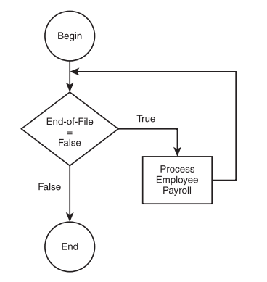
Looping with Conditions
Loops rely on conditions (similar to if statements) to determine if they should continue or stop.
while (end-of-file == false )
process employee payroll
Loop
Condition: end-of-file == false
Process repeats until the condition becomes true.
Notes:
STR: Store a value to memory.
ADD: Add two values.
SUB: Subtract one value from another.
MOV: Move data from one location to another.

Slide 8

Looping with Conditions
while (supply > 0) {
if (coins_inserted >= price) {
dispense_snack();
supply--; }
else { display_message("Insufficient funds"); }
}
Notes:
STR: Store a value to memory.
ADD: Add two values.
SUB: Subtract one value from another.
MOV: Move data from one location to another.

Slide 9
Loop Condition at the End
Similar to the while loop, but the loop executes at least once because the condition is checked after the loop body meaning it will once execute even if condition is false.
Ensure an action happens at least once.
Do
display message: "Enter a positive number."
input number
While number <= 0
The user is prompted to input a number.
If the input is negative or zero, the message reappears until a positive number is entered.
Notes:
STR: Store a value to memory.
ADD: Add two values.
SUB: Subtract one value from another.
MOV: Move data from one location to another.

Slide 10
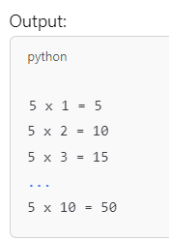
Known number of iterations
When we want to repeat statements for known number of times.
for i = 1 ; i <= 10; i++
display ” i ”
end for
The loop iterates through numbers 1 to 10
Then displays the numbers
Notes:
STR: Store a value to memory.
ADD: Add two values.
SUB: Subtract one value from another.
MOV: Move data from one location to another.

Slide 11
Loops can be nested
Loops can have one loop inside another loop.
Imagine a classroom with rows of desks. You want to check each desk for any items left behind.
for each row:
for each chair in the row:
check if there's anything left on the desk
Code Snippet:
for (int i = 1; i <= rows; i++)
{ printf("Checking row %d:\n", i);
for (int j = 1; j <= columns; j++) {
printf("Checking desk %d in row %d\n", j, }
printf("\n");
}
Notes:
STR: Store a value to memory.
ADD: Add two values.
SUB: Subtract one value from another.
MOV: Move data from one location to another.

Slide 12
3 Types of loops
While
Do While
For Loop
Notes:
STR: Store a value to memory.
ADD: Add two values.
SUB: Subtract one value from another.
MOV: Move data from one location to another.

Slide 13
While Loop
While loop continues to execute a block of code as long as a given condition is true.
When we want to repeat a block of code as long as a condition is true, but the number of iterations/repetition/loops is/are unknown.
Syntax :
while (condition) { // statements }
Executes the loop body if the condition is true.
Continues until the condition becomes false.
Notes:
STR: Store a value to memory.
ADD: Add two values.
SUB: Subtract one value from another.
MOV: Move data from one location to another.

Slide 14
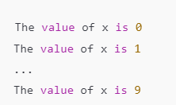
While Loop
int x = 0;
while (x < 10) // cannot make variables here
{ printf("The value of x is %d\n", x);
x = x + 1 ;
}
Initialization: x = 0.
Condition: x < 10 (Loop runs as long as true).
Increment: x = x + 1
Notes:
STR: Store a value to memory.
ADD: Add two values.
SUB: Subtract one value from another.
MOV: Move data from one location to another.

Slide 15
While Loop
Evaluate Condition: The loop starts by evaluating the condition. If the condition is true , the loop proceeds to execute the code inside its block. If the condition is false, the loop terminates, and control moves to the next statement after the loop.
Execute the Code Block: If the condition is true, the program executes the code within the { } brackets (the body of the loop).
Re-evaluation of Condition: After executing the code block, the program returns to the condition to check if it’s still true.
Repeat or Exit: If the condition is still true, the loop will execute the code block again. This cycle continues until the condition becomes false.
Exit the Loop: When the condition becomes false, the while loop stops executing, and the program continues with the next line of code after the loop.
Notes:
STR: Store a value to memory.
ADD: Add two values.
SUB: Subtract one value from another.
MOV: Move data from one location to another.

Slide 16
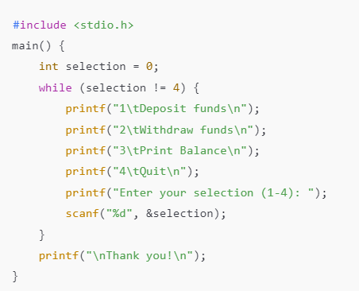
Notes:
Loops keep the menu active until the user chooses to quit.

Slide 17
Do While Loop
A do-while loop executes a block of code at least once, and then continues to execute as long as a given condition is true.
Similar to the while loop, but the loop executes at least once because the condition is checked after the loop body.
Condition is evaluated at the end, not at the beginning.
Syntax
do {
// statements
}
while (condition);
The while statement must end with a semicolon.
Notes:
STR: Store a value to memory.
ADD: Add two values.
SUB: Subtract one value from another.
MOV: Move data from one location to another.

Slide 18
Do While Loop
int x = 11;
do {
printf("This printf statement is executed at least once\n");
x = x + 1
} while ( x < 10 );
while ( x < 10 ) {
printf("This printf statement is never executed\n");
x = x + 1;
}
Notes:
STR: Store a value to memory.
ADD: Add two values.
SUB: Subtract one value from another.
MOV: Move data from one location to another.

Slide 19
Do While Loop
Execute the Code Block: The loop starts by executing the code inside the { } braces (the body of the loop) without checking the condition initially.
Evaluate Condition: After executing the code block once, the condition is then evaluated.
If the condition is true, the loop will repeat, returning to step 1 and executing the code block again.
If the condition is false, the loop will stop, and control will move to the next statement after the do-while loop.
Repeat or Exit: This cycle continues until the condition becomes false.
Notes:
STR: Store a value to memory.
ADD: Add two values.
SUB: Subtract one value from another.
MOV: Move data from one location to another.

Slide 20
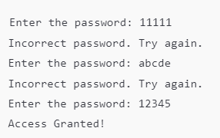
Do While Loop
do {
printf("Enter the password: ");
scanf("%s", password);
if (password != correctPassword )
{
printf("Incorrect password. Try again.\n");
}
} while (password != correctPassword );
printf("Access Granted!\n");
Use case : Any scenario where a user must retry until the correct input is provided.
Notes:
STR: Store a value to memory.
ADD: Add two values.
SUB: Subtract one value from another.
MOV: Move data from one location to another.

Slide 21
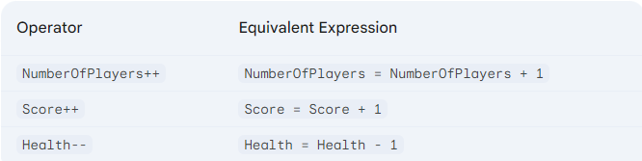
Increment/Decrement Operators
The ++ and - - operator is useful for incrementing number-based variables by 1. To use the ++ operator, simply put it next to a variable, as shown next.
Following are int or float datatype variables
NumberOfPlayers ++; → NumberOfPlayers = NumbersOfPlayers +1;
Score ++; → Score = Score + 1
Health- -; → Health = Health -1;
Notes:
STR: Store a value to memory.
ADD: Add two values.
SUB: Subtract one value from another.
MOV: Move data from one location to another.

Slide 22
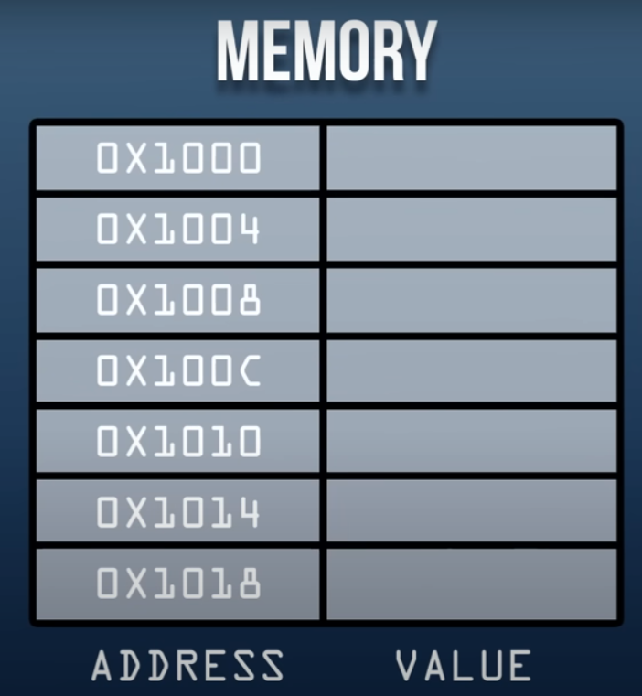





Increment/Decrement Operators
Int NumberOfPlayers = 2;
Notes:
STR: Store a value to memory.
ADD: Add two values.
SUB: Subtract one value from another.
MOV: Move data from one location to another.

Slide 23










Increment/Decrement Operators
Int NumberOfPlayers = 2;
NumberOfPlayers = NumbersOfPlayers + 1;
Notes:
STR: Store a value to memory.
ADD: Add two values.
SUB: Subtract one value from another.
MOV: Move data from one location to another.

Slide 24






Increment/Decrement Operators
Int NumberOfPlayers = 2;
NumberOfPlayers = NumbersOfPlayers + 1;
Notes:
STR: Store a value to memory.
ADD: Add two values.
SUB: Subtract one value from another.
MOV: Move data from one location to another.

Slide 25


Increment/Decrement Operators
Int NumberOfPlayers = 2;
NumberOfPlayers ++; //Same thing
Notes:
STR: Store a value to memory.
ADD: Add two values.
SUB: Subtract one value from another.
MOV: Move data from one location to another.

Slide 26
For Loop
Executes a block of code a specific number of times.
For Loop is used when we know the exact number of iterations in advance.
Syntax:
for (initialization; condition; increment/decrement)
{
// Code to execute
}
Compact Syntax: Combines initialization, condition, and increment/decrement in one line.
Notes:
STR: Store a value to memory.
ADD: Add two values.
SUB: Subtract one value from another.
MOV: Move data from one location to another.

Slide 27
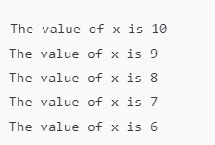
For Loop
Initialization: Sets the loop variable.
Condition: Checked before each iteration. The loop exits if false.
Update: Modifies the loop variable after each iteration.
main() {
for (int x = 10; x > 5; x--)
{
printf("The value of x is %d\n", x);
}
}
Starts with x = 10.
Runs while x > 5.
Decreases x by 1 after each iteration (x--).
Notes:
STR: Store a value to memory.
ADD: Add two values.
SUB: Subtract one value from another.
MOV: Move data from one location to another.

Slide 28
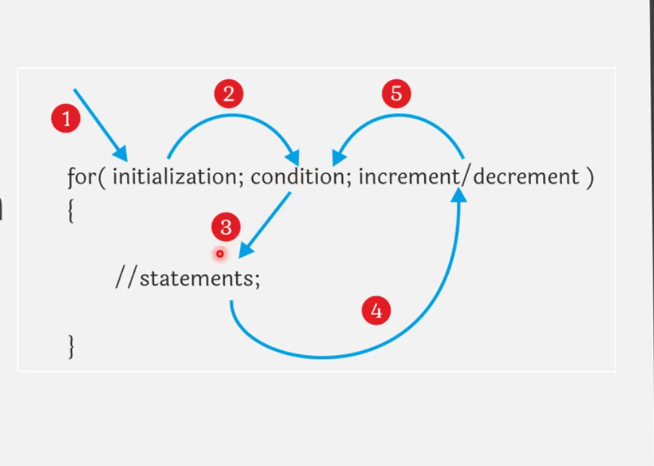
For Loop
Notes:
STR: Store a value to memory.
ADD: Add two values.
SUB: Subtract one value from another.
MOV: Move data from one location to another.

Slide 29
For Loop
For Loop Flow:
Initialization: Execute once before the loop starts.
Condition Check: If true, the loop runs; if false, the loop exits.
Loop Body: Code inside the loop is executed.
Increment/Decrement: Adjusts the loop variable.
Repeats steps 2-4 until the condition is false.
Notes:
STR: Store a value to memory.
ADD: Add two values.
SUB: Subtract one value from another.
MOV: Move data from one location to another.

Slide 30
Break And Continue
The break and continue statements are used to manipulate program flow in structures such as loops.
When a break statement is executed in a loop, the loop is terminated and program control returns to the next statement
You’re driving in a parking lot looking for an empty space. Once you find the first empty spot, you park and stop looking further.
Notes:
STR: Store a value to memory.
ADD: Add two values.
SUB: Subtract one value from another.
MOV: Move data from one location to another.

Slide 31
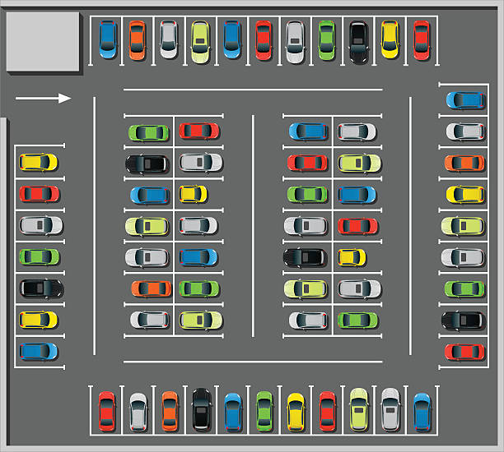


Break And Continue
Notes:
STR: Store a value to memory.
ADD: Add two values.
SUB: Subtract one value from another.
MOV: Move data from one location to another.

Slide 32
Break And Continue
int x;
for ( x = 10; x > 5; x-- )
{
if ( x == 7 )
break;
}
printf(“\n%d\n”, x);
Notes:
Imagine you’re searching for a specific item in a grocery list. Once you find it, there’s no need to continue searching.
{"Milk", "Bread", "Eggs", "Sugar", "Tea"}; if found then break

Slide 33

Break And Continue
int x;
for ( x = 10; x > 5; x-- )
{
if ( x == 7 )
break;
}
printf(“\n%d\n”, x);
the condition (x == 7) becomes true after the third iteration. Next, the break statement is executed and program control is sent out from the for loop and continues with the printf statement.
Notes:
Imagine you’re searching for a specific item in a grocery list. Once you find it, there’s no need to continue searching.
{"Milk", "Bread", "Eggs", "Sugar", "Tea"}; if found then break

Slide 34
Break And Continue
The continue statement is also used to manipulate program flow in a loop structure. When executed, any remaining statements in the loop are passed over and the next iteration of the loop starts.
Imagine you're checking a list of 10 tasks to complete. You want to skip task number 5 because it's already done.
Notes:
STR: Store a value to memory.
ADD: Add two values.
SUB: Subtract one value from another.
MOV: Move data from one location to another.

Slide 35
Break And Continue
int x;
for ( x = 1; x < 10; x++ )
{
if ( x == 5 )
continue;
printf(“\n%d\n”, x);
}
printf(“Loop is Finished”);
when the condition x == 5 is true, the continue statement is executed, thus skipping the printf() function and continuing program flow with the next iteration of the for loop.
Notes:
You’re checking your pantry to see which items from your grocery list are missing. If you already have an item, you skip it and continue checking the rest.
char *groceryList[] = {"Milk", "Bread", "Eggs", "Sugar", "Tea"};
char *inPantry[] = {"Milk", "Sugar"};

Slide 36


